Slide 1
Linux Operating Systems & Command-line interface
Lecture 8

Slide 2
1. Learning Outcomes
By the end of this lecture you will:
Understand the Linux operating system and its function
Be familiar with its folder and file structure
Understand Linux file permissions
Be familiar with text based command line functions in Linux
1. Learning Outcomes
2. History of Linux
3. Linux OS features

Slide 3

2. History of Linux
Linux began in 1991 as a personal project by Finnish student Linus Torvalds.
Since the release of its open source code, it has grown from a small number of C files to 23 million lines of code.
Started it for fun but ended up with such a large project.
It is free operating system
Some would say: Limited support
(vastly improved – written by contributors)
1. Learning Outcomes
2. History of Linux
3. Linux OS features

Slide 4

2.1 Distros
1. Learning Outcomes
2. History of Linux
2.1 Distros
2.1 Who use Linux?
3. Linux OS features

Slide 5




2.1 Who use Linux
Some Big names that use Linux
1. Learning Outcomes
2. History of Linux
2.1 Distros
2.1 Who use Linux?
3. Linux OS features

Slide 6
3. Linux OS features
As with file system construction; operating system’s all operate in a different manner (ext3) file system
Mostly used in server OS for web servers, database servers, file servers, email servers
This makes the software non-compatible between
systems(Windows, Linux)
1. Learning Outcomes
2. History of Linux
3. Linux OS features
4. Comparison (Windows vs Linux)
It has features like:
Open Source - availability to all contributors
Multi-User environment - access many resources
disk/ram/application at same time
Multiprogramming – multiple applications can run at same time

Slide 7
3. Linux OS features
Standard File System – Hierarchy of directories and files
Security – authentication protection, controlled access and
encryption
Shell – Command line interpreter
1. Learning Outcomes
2. History of Linux
3. Linux OS features
4. Comparison (Windows vs Linux)

Slide 8
4. Comparison (Windows vs Linux)
Topic | Linux | Windows
Price (cost) | YES
Ease of Use (graphic interface) | YES | YES
Reliability (up-time) | YES
Software (availability) |  | YES
Hardware (compatibility) |  | YES
Security (vulnerability) | YES
Support |  | YES
1. Learning Outcomes
2. History of Linux
3. Linux OS features
4. Comparison (Windows vs Linux)
5. Using the OS (Linux)
Result 50/50 depends on user requirements

Slide 9
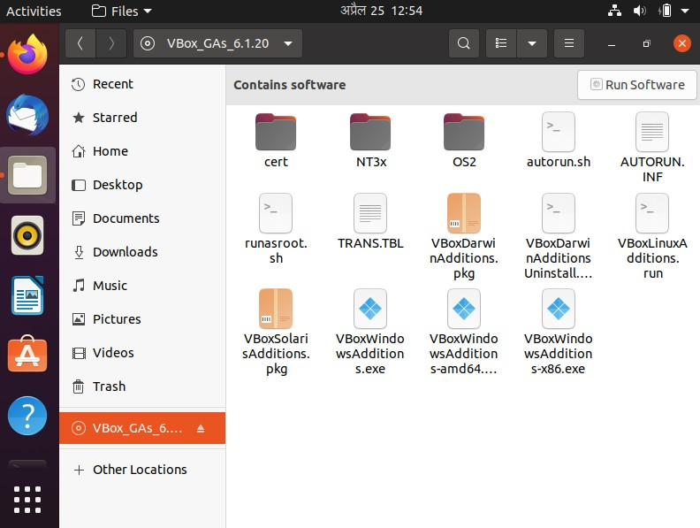
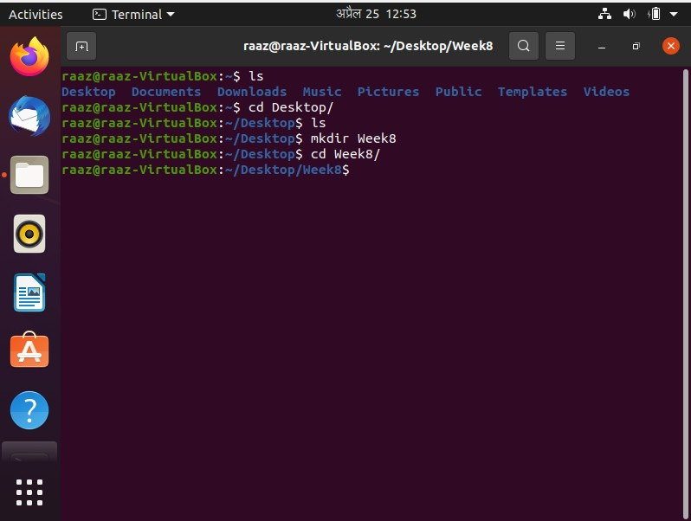
5.Using the OS (Linux)
Very (very) similar to the Microsoft Windows
User Interface –
Graphical
(a window + mouse)
Linux desktop
Text based
(command line + type)
[terminal]
1. Learning Outcomes
2. History of Linux
3. Linux OS features
4. Comparison (Windows vs Linux)
5. Using the OS (Linux)
6. Terminal

Slide 10

6. Terminal
Terminal is a command line program which is pre-installed on Linux
Allows you to navigate through folders and
execute files (file and folder management)
Gives easy access to add arguments to executable programs or commands
E.g.
Windows allows you to double click on executables, some versions of Linux need the terminal - ./nameofprogram.sh
6. Terminal
7. How do you Run Linux on Windows ?
8. Terminal Command Groups

Slide 11
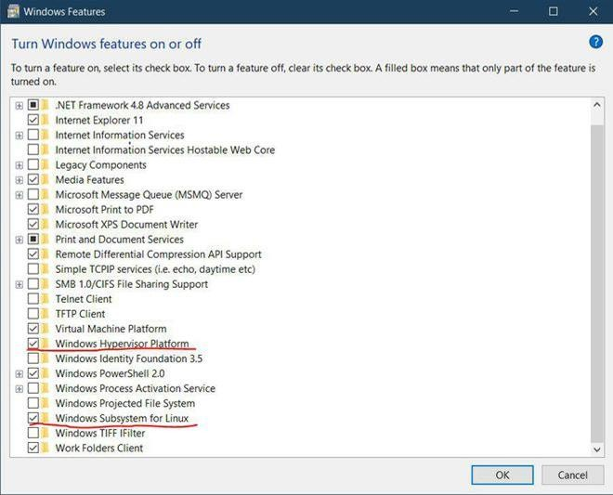
7. How do you Run Linux Terminal on Windows?
Windows Subsystem for Linux (WSL)
Step 1: Enable the Windows Subsystem for Linux optional feature.
You can enable it using the ‘programs and features’ settings.
6. Terminal
7. How do you Run Linux on Windows ?
8. Terminal Command Groups

Slide 12
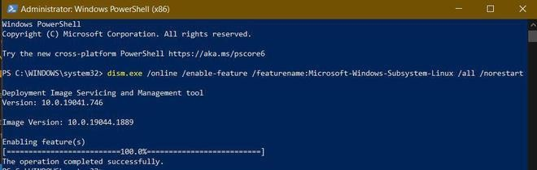
7. How do you Run Linux Terminal on Windows? (contd..)f
Windows Subsystem for Linux (WSL)
Step 2:Enable the Virtual Machine platform and Install WSL2.
The virtual machine has to be enabled before
installing WSL, this can be done using the following command.
6. Terminal
7. How do you Run Linux on Windows ?
8. Terminal Command Groups
dism.exe /online /enable-feature /featurename:Microsoft-Windows-Subsystem-Linux /all /norestart

Slide 13
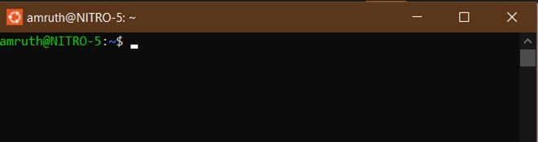
7. How do you Run Linux Terminal on Windows? (contd..)
Windows Subsystem for Linux (WSL)
Open Powershell or command-prompt
and write the following command.
wsl --install
wsl --set-default-version 2
Step 3: Download and Install a Linux distribution from Microsoft Store.
6. Terminal
7. How do you Run Linux on Windows ?
8. Terminal Command Groups

Slide 14
8. Terminal Command Groups
Terminal Navigation Commands –
These commands help the user navigate the system. No amount of terminal knowledge will help you if you can’t change directories or get help on a command you don’t remember how to use.
File Management Commands –
6. Terminal
7. How do you Run Linux on Windows ?
8. Terminal Command Groups
9. Terminal Navigation Commands (some)

Slide 15
8. Terminal Command Groups
File Management Commands –
Most Linux distributions come with a graphical desktop environment — but for complicated tasks, it’s often easier and faster to use the command line.
⚪ $ tar xvzf file.tar.gz -C /path/to/somedirectory
System Management Commands –
These time-tested commands tend to offer a lot more
power in terms of what you can do.
6. Terminal
7. How do you Run Linux on Windows ?
8. Terminal Command Groups
9. Terminal Navigation Commands (some)

Slide 16

9.Terminal Navigation Commands (some)
ls [No arguments needed] – list current directory (folder) content with highlighting (files and folders) e.g.
9. Terminal Navigation Commands (some)
10. File Management Commands (some)
11. Permissions
[ NB// blue = folder name ]
[white = file name ]
pwd – current directory (absolute address)
cd “NameOfFolder” – change directory (folder)
man - Displays a help page (manual), very useful
for learning how to use a command.

Slide 17
10. File Management Commands (some)
mkdir – make directory (folder)
rmdir – remove directory (folder)
cat — When used on a single text file, it will
display the contents of that file
cp — Makes a copy of a file (same directory)
find — Searches to find files that match a given
set of criteria
mv — Moves a file (source to target)
rename — Changes the name of a file
rm — Removes a file(s) that match a criteria
zip — Various formats for compressing and decompressing file archives
Chmod — Changes permissions (file / folder)
9. Terminal Navigation Commands (some)
10. File Management Commands (some)
11. Permissions

Slide 18
11. Permissions
⚪By default Linux applies permissions to files
(and folders)
⚪There are 3 types of permissions, read, write and
execute
⚪Numerically values can be represented as:
0 = No Permission, 1 = Execute, 2 = Write, 4 =Read
⚪We can use chmod to change mode (permissions)
chmod 400 file - Read by user chmod 040 file - Read by group
chmod 004 file - Read by other (World )
chmod 200 file - Write by user chmod 020 file - Write by group
chmod 002 file - Write by other (World)
chmod 100 file - execute by user chmod 010 file - execute by group
chmod 001 file - execute by other (World)
9. Terminal Navigation Commands (some)
10. File Management Commands (some)
11. Permissions

Slide 19
11.1 Changing Permissions
For example : chmod 700
Sum the value (by collective;owner, group, world)
chmod 400 file - Read by user
chmod 040 file - Read bygroup
chmod 004 file - Read by other (World)
chmod 200 file - Write by user
chmod 020 file - Write by group
chmod 002 file - Write by other (World)
chmod 100 file - execute by user
chmod 010 file - execute by group
chmod 001 file - execute by other (World)
So; 400 + 200 + 100 = 700
Thus;700 means Read/Write/Execute by USER
only [ chmod 777 = give full access to everyone ]
11. Permissions
11.1. Changing Permissions
11.2 Viewing Permissions

Slide 20
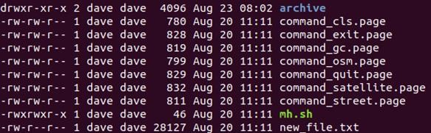
11.2 Viewing Permissions
The letters represent
r: Read permissions. (opened and viewed)
w: Write permissions. (edited, modified, and deleted)
x: Execute permissions. (program can be run)
-: No permission has been granted
Thus; rwx means full permissions have been granted by collective
11. Permissions
11.1. Changing Permissions
11.2 Viewing Permissions

Slide 21
12. System Management Commands (some)
df — Displays disk free space on your system
free — Displays RAM (used and free)
ip — Displays network details, can also be used
to configure network-related settings
ps — Displays currently running processes
whoami — Displays the current user name
mount/umount — Attaches and detaches a
separate filesystem (e.g. hard drives or USB)
kill/killall — Use to end a process according to
its process ID (often used in conjunction with the ps command) whereas you can use killall to end all processes whose names match your query.
12. System Management Commands (some)
13. Linux Scripts
14. Summary

Slide 22
12. System Management Commands (contd.)
Need to know of……...
Install new packages, upgrade packages,remove packages,etc.
apt (advanced package tool) – although
it isn’t a command in itself, there are three commands that you must know to make full use of apt:
add-apt-repository (for locating third-party packages)
apt-get (for actually installing packages)
apt-cache (for searching your repositories)
[ If your Linux version doesn’t use APT, it may use YUM, RPM, or some other alternative ]
12. System Management Commands (some)
13. Linux Scripts
14. Summary

Slide 23
13. Linux Scripts
Similar to Microsoft Batch files (.bat) Linux shell scripts can be created and executed (.sh)
Stages
Create a file using a the vi editor (or any other-editor). And
Name the script file with extension .sh
Start the script with #!/bin/sh
⚪ ["#!" is an operator called shebang which directs the script to the interpreter location ]
Write some code (script)
Save the script file as filename.sh
For executing the script type bash filename.sh
Example script
#!/bin/sh
echo “What is your name?" read name
echo "How do you do, $name“
12. System Management Commands (some)
13. Linux Scripts
14. Summary

Slide 24
14. Summary
Another OS but FREE
Selection of OS should be made and depend on user needs
Linux uses a Familiar file and directory structure
Command line commands permit navigation, file control and system management
Linux uses an effective simple file permission system
Shell scripts can be written that execute similar to that of (windows) batch files.
13. Linux Scripts
14. Summary
15. Workshop

Slide 25
15. Workshop
Complete Linux Workshop/Assignment material
Submission date is the end of module.
13. Linux Scripts
14. Summary
15. Workshop

Slide 26

WOW!
THANK
YOU

